Slide 1
Thermal Image Pin Detection & Recognition
Eric Romero & Justin Guerra
COSC 4590.001
Digital Image Processing and Computer Vision Fall 2015
Dr. Maryam Rahnemoonfar

Slide 2
Overview
Design
Method
Contributions
Dataset
Results
Problems
Conclusion
Additions

Slide 3
Design…

Slide 4
Design
A thermal recognition software designed specifically to identify Personal Identification Numbers (PIN) from a recently used access point.
Pros:
An innovative security software
A tool to help increase security
A tool to help reduce data theft
A potential tool for investigations
Cons:
Malicious users
Identity theft
Weakens access points that use PIN pads

Slide 5


Slide 6
Method…

Slide 7
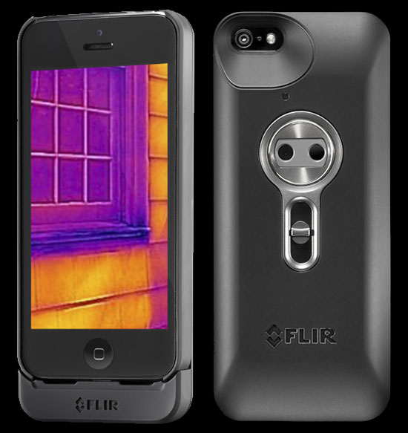



Method
Science fiction + Mozzie = The idea
Research lead to a document
Heat of the Moment: Characterizing the Efficacy of Thermal Camera-Based Attacks
Tools used:
OpenCV
FLIR C2
git
Approach
Used Mat objects
Scalar() function
Many more…

Slide 8

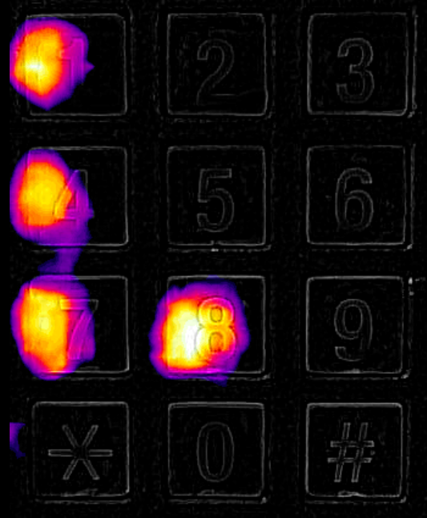
Before PIN is entered
After PIN is entered

Slide 9
Method
Research
Max
With the max method, each ROI was represented by the maximum temperature recorded within the region. We found that, while this did pull out high temperatures caused by user warmth, it also fell prey to higher noise in blank regions.
Mean
With the mean method, each ROI was represented as the arithmetic mean of its intensities. This method did a far better job than the max method of smoothing out noise; still, we observed that old or light keypresses sometimes provided a very small movement in the mean. Overall, however, this method achieved the best performance out of the three.
Binarize
Finally, for the binarize method, we compared each pixel against its counterpart in the calibration frame. If its temperature increased, we treated it as a 1; otherwise, as a 0. By then applying the mean method to the binarized image, we can gain a measure of how much of the ROI has increased in temperature.

Slide 10
Contributions…

Slide 11
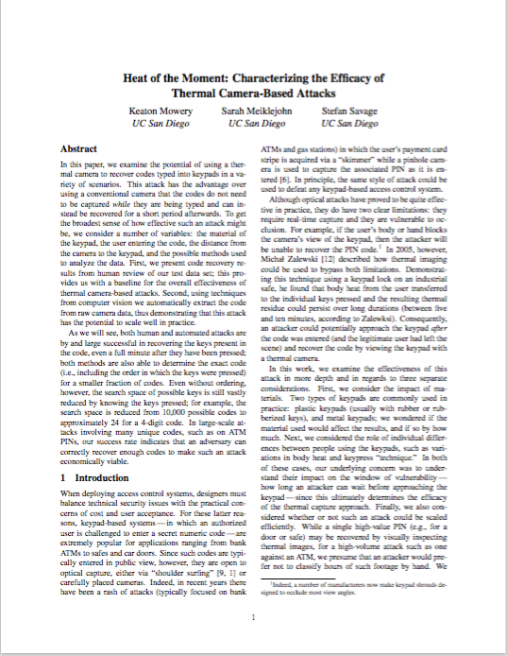
Our contributions – Eric & Justin
Problems:
How do we find the ROI?
Eric identified a method that would
allow us to split the image into 12 even sections.
How to identify presses within
each ROI?
Justin found an OpenCV method that
will allow us to work with
a specific channel.
Approach:
Can this be done completely autonomously? (ongoing…)
- Justin
Identify a press (complete…)
- Eric

Slide 12
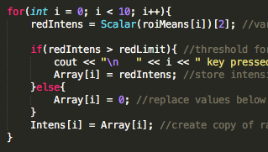
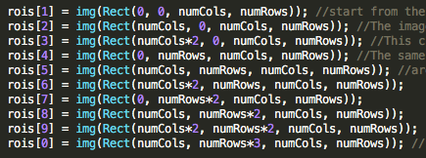
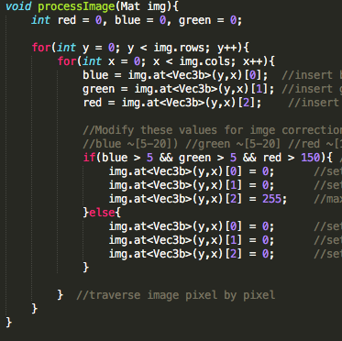


contributions – Eric (complete)
Returning ROIs with the highest mean values
Create ROI regions within the image
Remove all colors but red
Calculate the mean values of ROIs
Sort the mean values

Slide 13

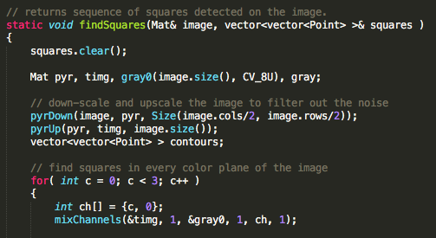

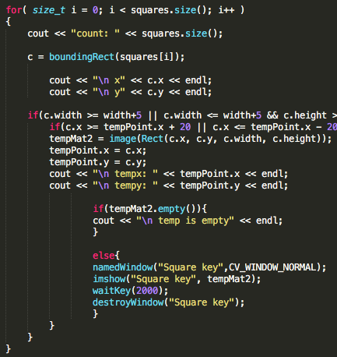
Contribution – Justin (ongoing)
User visually identifies the key
Trying to filter the keys autonomously
Cited: Nash. “Detecting shapes in an image” opencv-code.com
Dec. 17 2012. 10. 20. 2015 was accessed.
http://www.easybib.com/reference/guide/mla/website

Slide 14
DATASET…

Slide 15
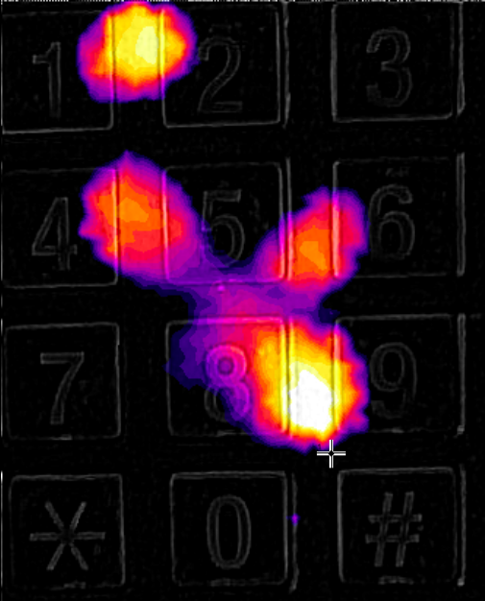
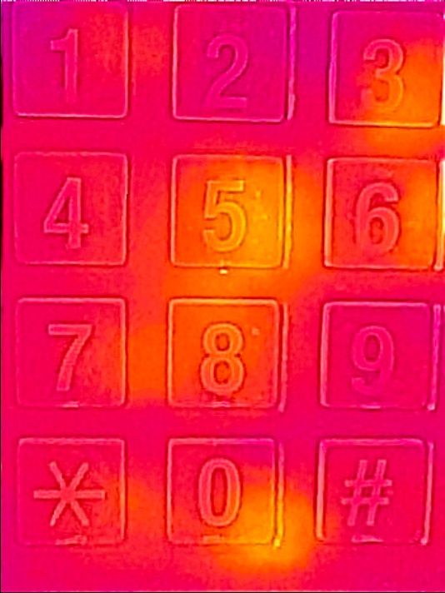
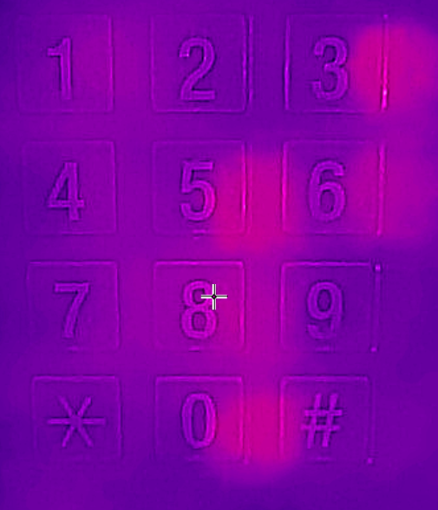
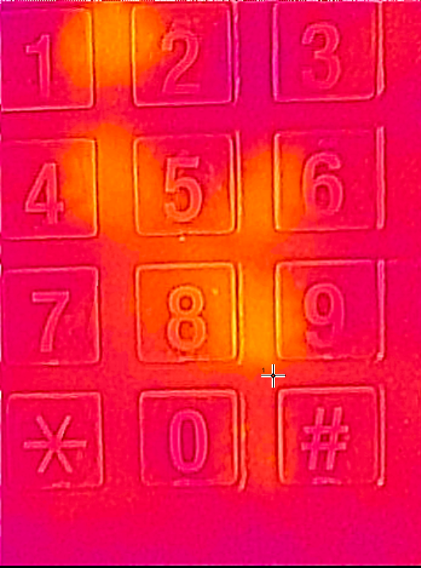
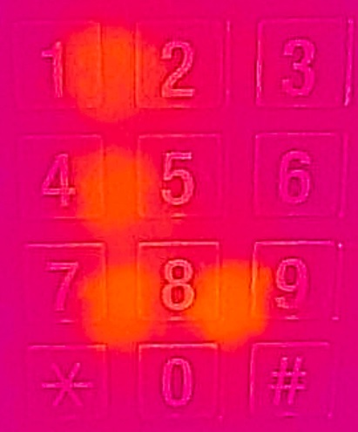

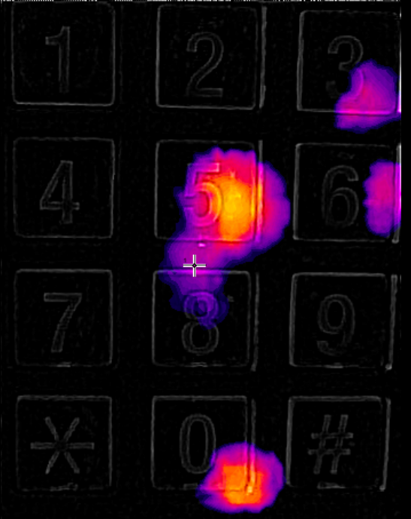
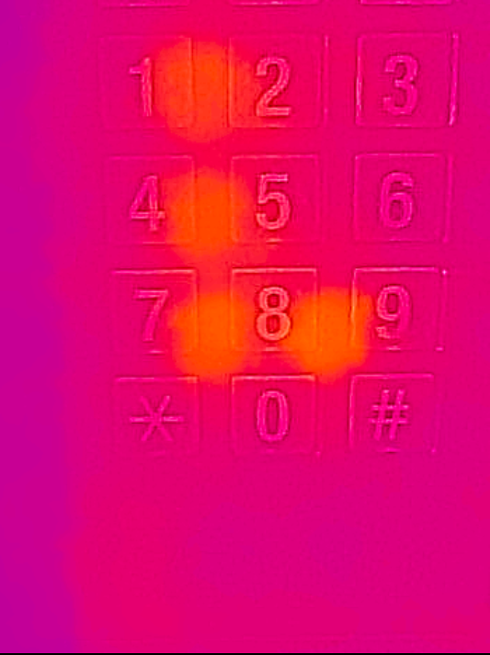
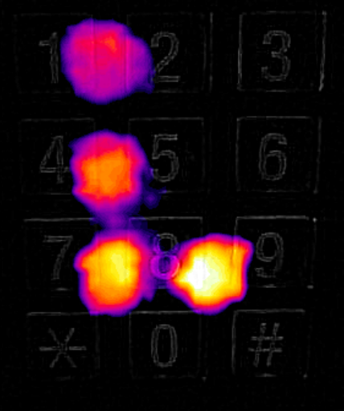
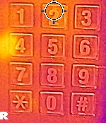
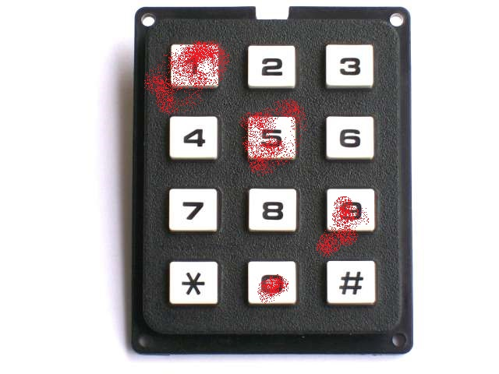
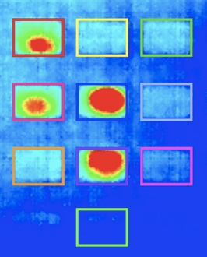
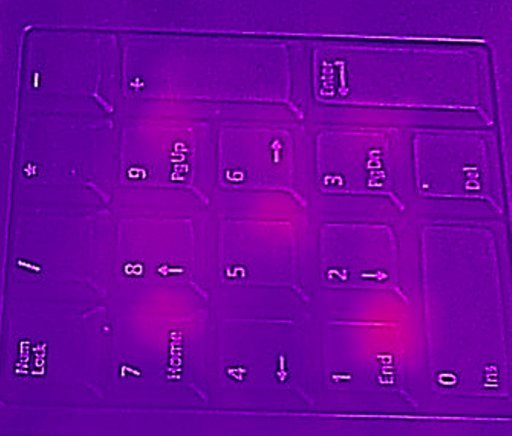
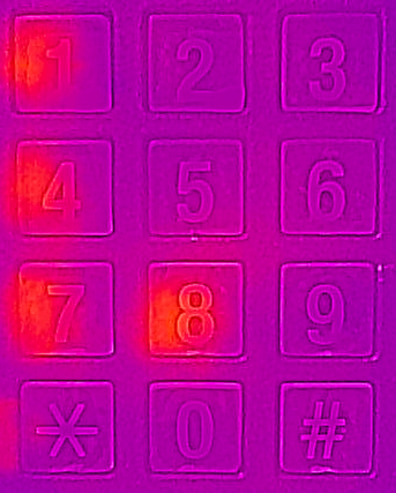

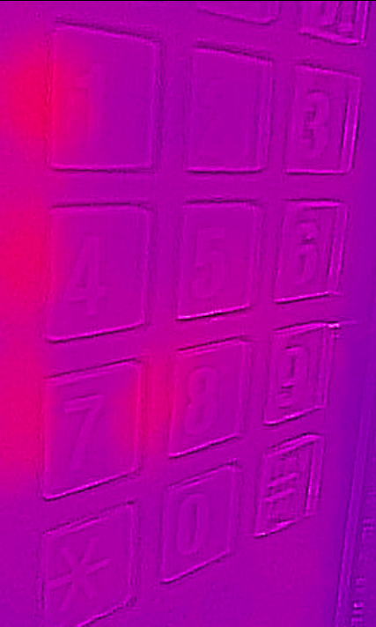
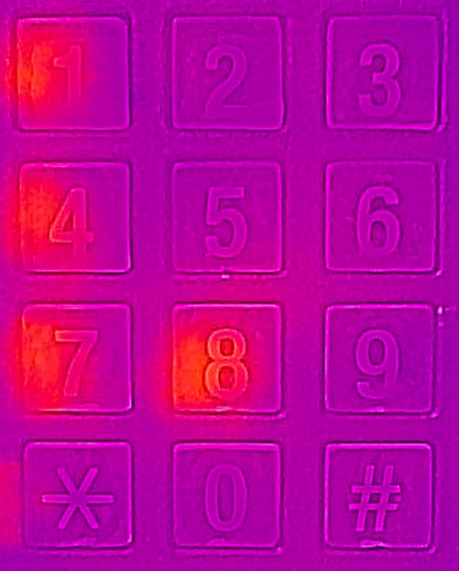
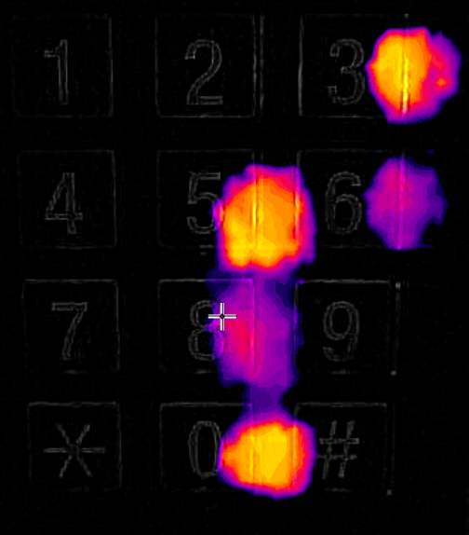
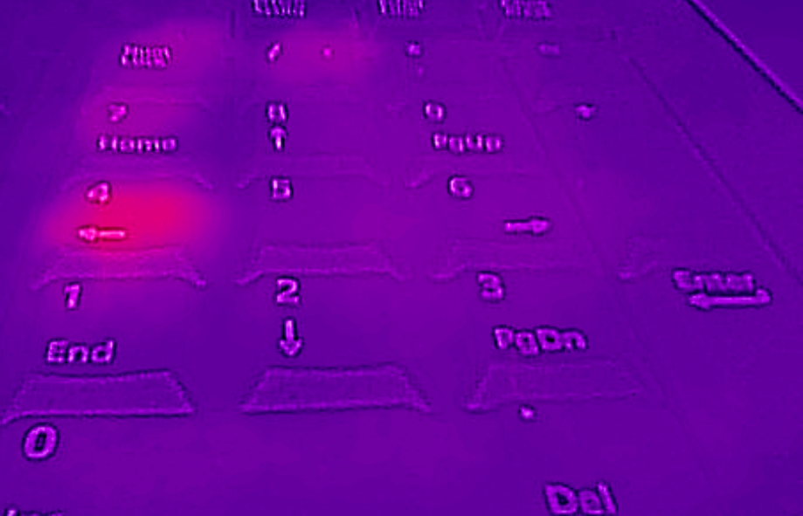

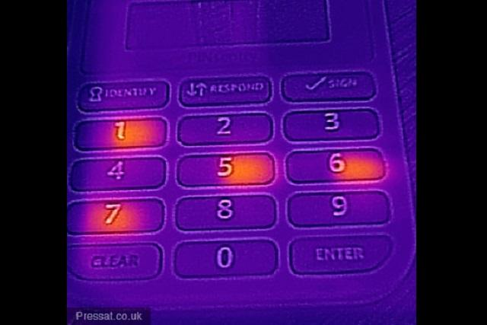
Dataset

Slide 16
Results…

Slide 17
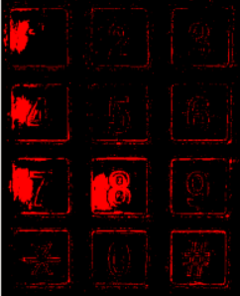
Results
Raw
Processed

Slide 18
Problems…

Slide 19
Problems
Poor picture
Too faint of a press
Too many or too few presses
Waited too long after the input of pin
Access point location temperature too hot or cold
Access points with LEDs behind keys
Double key press

Slide 20
Conclusion…

Slide 21
Conclusion
How to identify a press?
Find Red channel average for full image
Parse the image into 10 ROIs (Numbers 0 – 9)
Find Red channel average for each ROI
Collect top four ROIs with a Red channel average higher than the full image
Identify all possible permutations of the 4 digit PIN
Can this be done a autonomously?
Autonomous key identification is not always accurate
Other objects that are not keys are identified
How do we find the ROI?
Divide the image into 12 sections, use only the number sections

Slide 22
Additions…

Slide 23
Additions
More Optimization
Add GUI
Develop Mobil App with camera grid design
Research other applications

Slide 24
FIN

